Slide 1

Forecasting tourist arrivals with machine learning and internet search index
GROUP 25
PRESENTER:
REDDY SAI SRINIVAS KAMAKOTI ( 220390110 )
KUSHAGRA JHA ( 240005713 )

Slide 2
CONTENT
CONTEXT & MOTIVATION
METHODOLOGY & DATA EXTRACTION
PRACTICAL LINK UPS & FUTURE PROCEEDINGS

Slide 3
CONTEXT & MOTIVATION
CONTEXT: The study emphasizes on how tourism significantly impacts GDP and employment, necessitating accurate arrival forecasts for effective planning and marketing. Integrating internet search indices with traditional data captures real-time trends, enhancing prediction accuracy.
MOTIVATION: Machine learning models improve forecast accuracy by identifying complex data patterns. Integrating internet search indices provides real-time insights into travelers' intentions, enhancing responsiveness to changes in behavior. This leads to better strategic decisions and optimized resource allocation in the tourism sector.

Slide 4
AIM & RESEARCH QUESTIONS
AIM: The aim is to enhance the precision of tourist arrival forecasts by integrating machine learning techniques with internet search indices. This approach seeks to utilize real-time data reflecting travelers' interests and intentions for more accurate predictions. Improved forecasting will support more effective resource planning, marketing strategies, and infrastructure development in the tourism sector. Ultimately, the goal is to create a reliable and dynamic predictive tool for industry stakeholders.
RESEARCH QUESTIONS: The research seems to focus on –
How do different machine learning algorithms compare in forecasting tourist arrivals using historical data and internet search indices?
To what extent can internet search indices serve as accurate predictors of tourism demand?
How can the integration of search indices with historical tourism data improve the accuracy of forecasting models?
What is the impact of external factors such as global events and economic shifts on the performance of these forecasting models?

Slide 5
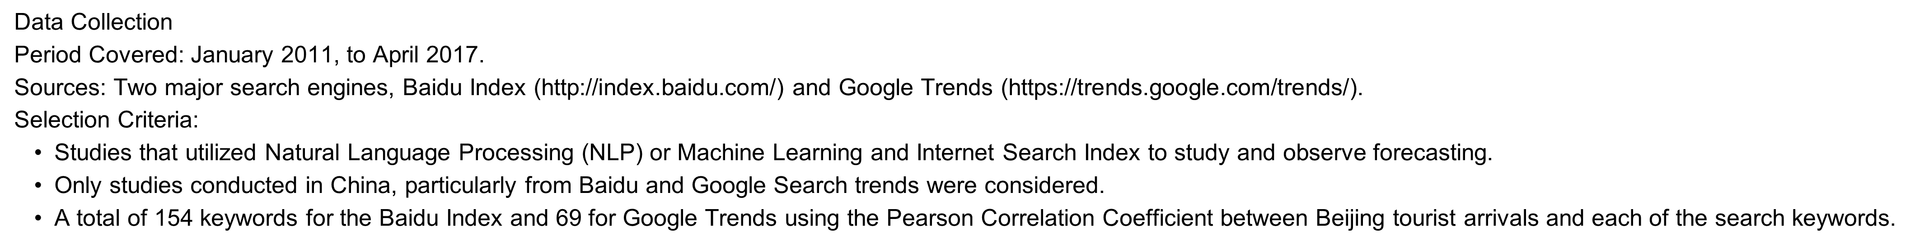
DATA COLLECTION AND METHODS OF ANALYSIS
Methods of Analysis
first construct both Baidu and Google internet search indexes by composite leading search index.
Secondly, test the co-integration and Granger causality between the tourist arrivals and these two indexes.
Thirdly, design different forecasting models in terms of tourist arrivals series and these two indexes and evaluate the in-sample and out-of-sample forecasting performance of each model.
Finally, the robustness of all forecasting models is analyzed, and conclusions are drawn from the empirical analysis.

Slide 6
METHODOLOGY
Proposed a kernel extreme learning machine with different kernel functions to accurately forecast tourist arrivals.
Co-integration and Granger causality relationship between search engine query data and tourist arrivals are verified.
Baidu index and Google trends data are simultaneously regarded as exogenous variables to forecast Beijing tourist arrivals.
Our proposed approach significantly improves the forecasting performance better than other benchmarks used in this study.

Slide 7
MAIN FINDINGS
ENHANCED PREDICTIVE ACCURACY:
Improves the accuracy of forecasting models for tourist arrivals compared to traditional methods.
High-frequency data captures real-time interest and potential travel intentions of tourists.
MACHINE LEARNING SUPERIORITY:
Models such as Support Vector Machines (SVM), Random Forests, and Neural Networks outperform traditional statistical models like ARIMA and Exponential Smoothing in predicting travel arrivals.
These models can handle non-linear relationships and large datasets more effectively.
TEMPORAL AND SPATIAL PATTERNS: Seasonal and Monthly, regional preferences and interests align with actual travel behavior.
COMPLEMENTARY DATA SOURCES: In China, Baidu has a higher user base. So, the dual approach helps capture a wider audience with lesser bias than relying on a single source.
REAL-TIME MONITORING AND DYNAMIC ADJUSTMENTS: The use of internet search indexes allows for real-time monitoring and the ability to dynamically adjust predictions based on emerging trends, providing a more responsive and flexible forecasting tool.

Slide 8
LIMITATIONS
DATA QUALITY AND ACCESSIBILITY: Search indexes may include noise and irrelevant search queries with the need for preprocessing making the quality and accessibility, inconsistent.
BIAS IN SEARCH BEHAVIOUR: Search data may not fully represent the entire population’s behavior, particularly the regions with lesser internet access or the places not under search engines’ consideration.
LAG BETWEEN SEARCH AND TRAVEL: Search for travel and actual travel time’s lag can also complicate the timings of the forecast. Lag varies by destination and type of traveler.
MODEL COMPLEXITY AND INTERPRETABILITY: As the models provide high accuracy, they often cannot interpret precisely when compared to traditional models. Deep underlying predictions can be quite challenging for those models where transparent decision-making processes are needed.
DEPENDENCE ON EXTERNAL FACTORS: Economic conditions, natural disasters, political events, and sudden changes in travel policies (e.g., the COVID-19 pandemic) can cause abrupt changes in search patterns that are difficult to predict.

Slide 9
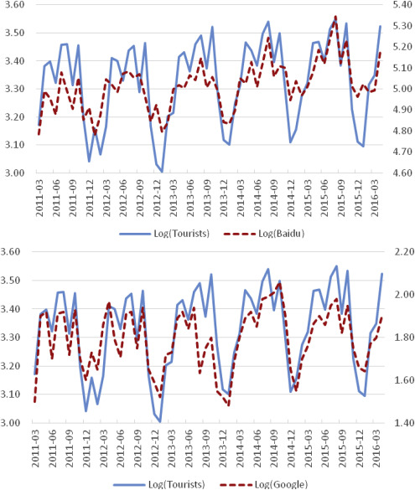
IMPORTANT GRAPH

Slide 10
ABOUT GRAPH
To reduce the impact of outliers, these three variables were converted to logarithmic form (LogT, LogBI, and LogGI). The graph provides the stability test and the Johansen co-integration test among LogT, LogBI, and LogGI. These three-time series are stable and validated by the augmented Dickey-Fuller test. The co-integration results demonstrate that LogT and LogBI are co-integrated. Similarly, LogT and LogGI are also co-integrated. Therefore, a long-term co-integration relationship exists between Internet search indexes and Beijing tourist arrivals. These findings suggest that adopting Internet search indexes to predict tourist arrivals from an econometric perspective is feasible.
The purpose of the Granger causality tests is to verify whether these two Internet search indexes are predictors of Beijing tourist arrivals. As shown in the graph, there is a causal relationship between the data of these two Internet search indexes and actual Beijing tourist arrivals.

Slide 11
SUGGESTIONS FOR FUTURE RESEARCH
Beyond predicting tourist numbers, the forecasting framework that combines machine learning with internet search data can also tackle other challenging prediction tasks. This includes projecting trends in the stock market, anticipating crude oil prices, and estimating future currency exchange rates.
More test cases and overcoming limitations by taking more datasets and combining traditional ways into the machine learning models can minimize the bias and other limitations

Slide 12
CONCLUSION
The paper introduces a KELM forecasting model that leverages machine learning and search data to predict tourist numbers, proving more precise than traditional methods. It’s beneficial for tourism management and policy-making, with potential applications in finance and economics. Limitations include its focus on Beijing and the need for a dynamic keyword strategy to adapt to evolving market conditions.

Slide 13

Thank You

